Slide 1
Topside Ionospheric Sounding
A Science Package for Phase 4

Slide 2
Some Background
The ionospheric sounder or Ionosonde is one of the most useful tools available to the radio amateur for predicting H.F. propagation.
Ionograms provide much more immediate and localized propagation information than solar indices.
Much of what we know about the ionosphere is derived from ground based ionospheric sounding

Slide 3
The Lowell Digisonde
The Lowell Digisonde is the dominant player in the ionsonde business, with a large network of Digisonde sounders deployed around the world. The ionograms and other data from most of these sites are readily available to radio amateurs over the web. http://digisonde.com/digisonde.html

Slide 4
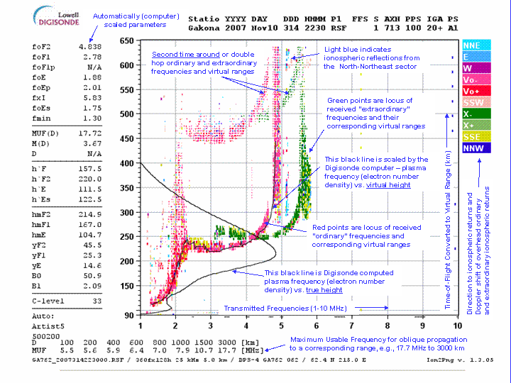
A Typical Digisonde Ionogram

Slide 5
Limitations of Ground Based Ionosondes
As useful as the ground based ionosonde is, it is impossible to obtain any information above the critical height, that is, the height at which the critical frequency occurs.
This leaves a large region of the Ionosphere as an “ignorosphere,” since any real-time information is next to non-existent

Slide 6
Previous Top-Side Sounding Attempts
Most Top-Side (down-looking) ionosondes have been deployed on scientific rockets, giving brief, fleeting information about the ionospheric top-side.
A few short-lived sounding stations have been deployed on relatively low-orbiting satellites.
At this time there are no permanent top-side ionospheric sounders.

Slide 7
A Geosynchronous Digisonde?
A permanent top-side sounder on Phase 4 would fill a much needed gap in ionospheric knowledge, not just for propagation prediction, but for more advanced ionospheric studies. This would truly give the Amateur Radio community an opportunity to “advance the radio art.”

Slide 8
Challenges
There are numerous engineering challenges to be met in deploying an effective topside sounder on Phase 4 (or related) Geosynchronous Satellites. Most of these can be solved with good engineering and clever design. The following slides will describe each of these challenges in detail, with possible solutions.

Slide 9
Range Resolution Challenges
Previous topside sounders operated JUST at the upper limit of the ionosphere, where the range resolution challenges were comparable to ground based ionosondes…just upside down. Range resolution on the order of 10Kilometers is fairly easily achieved with moderate bandwidth pulse transmissions, with either ground based or historic topside sounders.

Slide 10
Range Resolution Issues, cont.
A geosynchronous orbit ionosonde will be approximately 25X the height of the upper ionosphere. As a percentage of the total time-of-flight, the depth of the ionosphere is quite small. To get meaningful range resolution within that depth will require either very wide bandwidth or exotic signal processing and compression. The latter is most likely preferable.

Slide 11
Path Loss
While the free space path loss will be significant at H.F., it will not be an insurmountable problem. Similar path lengths are spanned routinely by radio amateurs using moderate equipment. Most of the path loss will actually be in the ionosphere, not in the intervening 22,000+ miles of space.

Slide 12
Antenna Challenges
An effective H.F. antenna will probably be the biggest challenge for Phase 4 deployment. It has to be rather broadbanded, and should ideally have a gain of nearly 0dBi, between 2-20 MHz. This would require a fairly large antenna for a satellite. The antenna could possibly be incorporated into the solar panel structure, deployed after the satellite is in proper orbit.

Slide 13
Power Budget
While the required ERP of the ionosonde will fairly large, the short pulse and duty cycle nature of ionosonde transmissions (fundamentally radar), should keep the power consumption within reasonable limits. Also, soundings will be fairly infrequent, allowing plenty of recharge time between transmission.

Slide 14
What We Will Gain
Most of the Universe is in the plasma state, much like our Ionosphere. The more we know about the ionosphere in our own “back yard,” the more we will know about the far reaches of the Universe. Up till now, we have had only brief, fleeting glimpses of our own ionosphere above 250 miles. We can make a major contribution to physics research, extending our influence far beyond Amateur Radio

Slide 15
More Reading on Topside Sounding
http://www.jpier.org/PIER/pier116/21.11031102.pdf
http://ann-geophys.net/29/229/2011/angeo-29-229-2011.pdf
http://meetingorganizer.copernicus.org/EPSC2012/EPSC2012-558.pdf
http://ntrs.nasa.gov/archive/nasa/casi.ntrs.nasa.gov/20110011009.pdf

Slide 16
Conclusion
Radio Amateurs have a golden opportunity to be at the forefront of science and technology. Incorporating a science package such as an ionosonde on an Amateur geosynchronous satellite (or other science packages, as well) can increase our visibility as radio amateurs to new levels.

